Slide 1
Annual Training
Client Rights and Responsibilities
Minnesota Statutes, section 245D.04
&
Person Centered Planning

Slide 2
Service-Related Rights

Slide 3

Service-Related Rights
A person’s service-related rights include the right to:
Take part in the development and evaluation of the services that will be provided to me.
2. Have services and supports identified in the coordinated service and support plan and the coordinated service and support plan addendum provided in a manner that respects and takes into consideration the person’s preferences according to the requirements of 245D.07 & 245D.071.
3. Refuse or terminate services and be informed about what will happen if I refuse or terminate services.
4. Know, before I start to receive services from this program, if the program has the skills and ability to meet my service and support needs.

Slide 4
Service-related Rights - Continued
5. Know the conditions and terms governing the provision of services, including the program’s admission criteria and policies and procedures related to temporary service suspension and service termination
6. Have the program help coordinate and ensure the continuity of my care if I transfer to another provider.
7. Know what services this program provides and how much they cost, regardless of who will be paying for the services, and to be notified if those charges change.
8. Know, before I start to receive services, if the cost of my care will be paid for by insurance, government funding, or other sources, and be told of any charges I may have to pay.
9. To have staff that are competent and trained, who has professional certification or licensure, as required, and who meets additional qualifications identified in the person’s coordinated service and support plan or coordinated service and support plan addendum.

Slide 5
Protection Related Rights

Slide 6
Protection Related Rights
Have my personal, financial, service, health, and medical information kept private and be notified if these records have been shared2. Have access to my records and recorded information that the program has about me as allowed by state and federal law, regulation, or rule
Be free from maltreatment including abuse, neglect or financial exploitation by the program or its staff.
Be free from staff trying to control my behavior by physically holding me or using a restraint to keep me from moving, giving me medication I don’t want to take or that isn’t prescribed for me, or putting me in time out or seclusion; except if and when manual restraint is needed in an emergency to protect me or others from physical harm by using interventions as part of a positive support transition plan or successor provisions.
Receive services in a clean and safe environment.
Be treated with courtesy and respect and have my property treated with respect.
Be allowed to reasonably follow my cultural and ethnic practices and religion.
Be free from bias and harassment regarding my race, gender, age, disability, spirituality, and sexual orientation

Slide 7
Protection Related Rights Continued
9. Be informed about and to use the program's grievance policy and procedures, including knowing how to contact persons responsible for helping me to get my problems with the program resolved and how to file an appeal under the law.
10. Know the names, addresses and phone numbers, websites and email of people who can help me, including the ombudsman, and to be given information about how to file a complaint with these offices.
11. Exercise my rights on my own or have a family member or another person help me exercise my rights, without retaliation from the program.
12. Give or not give written informed consent to take part in any research or experimental treatment.
13. Choose my own friends and spend time with them in the community.
14. Have personal privacy including the right to use the lock on my bedroom and unit door.
15. Take part in activities that I choose in the community.
16. I have access to my personal possessions at anytime, including financial resources

Slide 8
Rights Restrictions

Slide 9
Rights Restrictions
Restriction of a client’s rights is allowed only if determined necessary to ensure health, safety, and well-being. Any restriction of a client’s rights must be documented in the coordinated service and support plan or coordinated service and support plan addendum. The restriction must be implemented in the least restrictive alternative manner necessary to protect the client and provide the client support to reduce or eliminate the need for the restriction in the most integrated setting and inclusive manner.

Slide 10
Documentation Required For a Rights Restriction
1. The justification (meaning the reason) for the restriction based on an assessment of what makes the client vulnerable to harm or maltreatment if the client was allowed to exercise the right without a restriction;
2. The objective measures set as conditions for ending the restriction (meaning the program must clearly identify when everyone will know the restriction is no longer needed and it has to end);
3. A schedule for reviewing the need for the restriction based on the conditions for ending the restriction to occur semiannually from the date of initial approval, at a minimum, or more frequently if requested by the person, the person's legal representative, if any, and case manager
and
4. Signed and dated approval for the restriction from the client or their legal representative, if any. A restriction may be implemented only when the required approval has been obtained. Approval may be with drawn at anytime. If approval is withdrawn, the right must be immediately and fully restored.

Slide 11
Other Restrictions
MN Statutes 245D.06 Subd. 5
Staff are prohibited from using the following as a substitute for adequate staffing, for behavioral or therapeutic program to reduce or eliminate behavior, as punishment, or for staff convenience:​
1. Chemical Restraints​
2. Mechanical Restraints​
3. Manual Restraints​
4. Time Out​
5. Seclusion​
6. Aversive or Deprivation Procedure

Slide 12
Definitions MN Statutes 245D.02
1. Chemical Restraints – administration of a drug or medication to control a person’s behavior or restrict the person’s freedom of movement and is not a standard treatment or dosage for the person’s medical or psychological condition.
2. Mechanical Restraints - use of devices, materials, or equipment attached or adjacent to the person’s body, or the use of practices that are intended to restrict freedom of movement or normal access to one’s body or body parts, or limits a person’s voluntary movement or holds a person immobile as an intervention precipitated by a person’s behavior. The term applies to the use of mechanical restraint used to prevent injury with persons who engage in self-injurious behaviors, such as head-banging, gouging, or other actions resulting in tissue damage that have caused or could cause medical problems resulting from the self-injury. (Does not include devices worn by the person that trigger alarms to warn staff that a person is leaving a room or area which do not, in and of themselves, restrict freedom or movement, or adaptive aids, equipment, or orthotic devices ordered by a health care professional used to treat or manage a medical condition)
3. Manual Restraints - physical intervention intended to hold a person immobile or limit a person’s voluntary movement by using body contact as the only source of physical restraint

Slide 13
Definitions MN Statutes 245D.02 Continued
4. Time Out - removing a person involuntarily from an ongoing activity to a room, either locked or unlocked, or otherwise separating a person from others in a way that prevents social contact and prevents the person from leaving the situation if the person chooses. Does not include voluntary removal for the purpose of calming, prevention of escalation or de-escalation of behavior; nor does it mean taking a brief break or rest from an activity for the purpose of providing the persona an opportunity to regain self-control.
5. Seclusion - the placement of a person alone in a room from which exit is prohibited by a staff person or a mechanism such as a lock, a device, or an object positioned to hold the door closed or otherwise prevent the person from leaving the room. Or involuntarily removing or separating a person from an area, activity, situation, or social contact with other as blocking or preventing the person’s return.
6. Aversive Procedure - application of an aversive stimulus contingent upon the occurrence of a behavior for the purposes of reducing or eliminating the behavior
7. Aversive Stimulus - means an object, event, or situation that is presented immediately following a behavior in an attempt to suppress the behavior. Typically, an aversive stimulus is unpleasant and penalizes or confines.
8. Deprivation Procedure - removal of a positive reinforcer following a response resulting in, or intended to result in, a decrease in the frequency, duration, or intensity of that response Oftentimes the positive reinforcer available is goods, services, or activities to which the person is normally entitled. The removal is often in the form of a delay or postponement of the positive reinforcer.

Slide 14
Person Centered Planning
MN Statutes 245D.07 Subd. 1a.

Slide 15

Person Centered Service Planning
Person-centered service planning and delivery is service that:
identifies and supports what is important to the person as well as what is important for the person, including preferences for when, how, and by whom direct support service is provided;
uses that information to identify outcomes the person desires; and
respects each person's history, dignity, and cultural background;
Self-determination that supports and provides:
• opportunities for the development and exercise of functional and age-appropriate skills, decision making and choice, personal advocacy, and communication; and
• the affirmation and protection of each person's civil and legal rights;

Slide 16

Person Centered Service Planning
Providing the most integrated setting and inclusive service delivery that supports, promotes, and allows:
• inclusion and participation in the person's community as desired by the person in a manner that enables the person to interact with nondisabled persons to the fullest extent possible and supports the person in developing and maintaining a role as a valued community member;
• opportunities for self-sufficiency as well as developing and maintaining social relationships and natural supports; and
• a balance between risk and opportunity, meaning the least restrictive supports or interventions necessary are provided in the most integrated settings in the most inclusive manner possible to support the person to engage in activities of the person's own choosing that may otherwise present a risk to the person's health, safety, or rights

Slide 17
Person Centered Service Planning is to ensure:
1. The opportunity for people to make their own choices whenever possible to support what makes them an individual – their history, personality, and cultural background.
2. Respect for individual rights and supportive of the individual's daily needs and preferences.
3. Inclusive service delivery that promotes self determination and personal advocacy.
4. Growth in the least restrictive, and most integrated setting as possible.
5. Services are provided in the most inclusive environment possible to enable the development of social relationships and natural supports.
6. Participation in each person we support’s community – in so much as that person is able and desires to. This will provide the opportunity for interaction with peers and nondisabled persons.

Slide 18
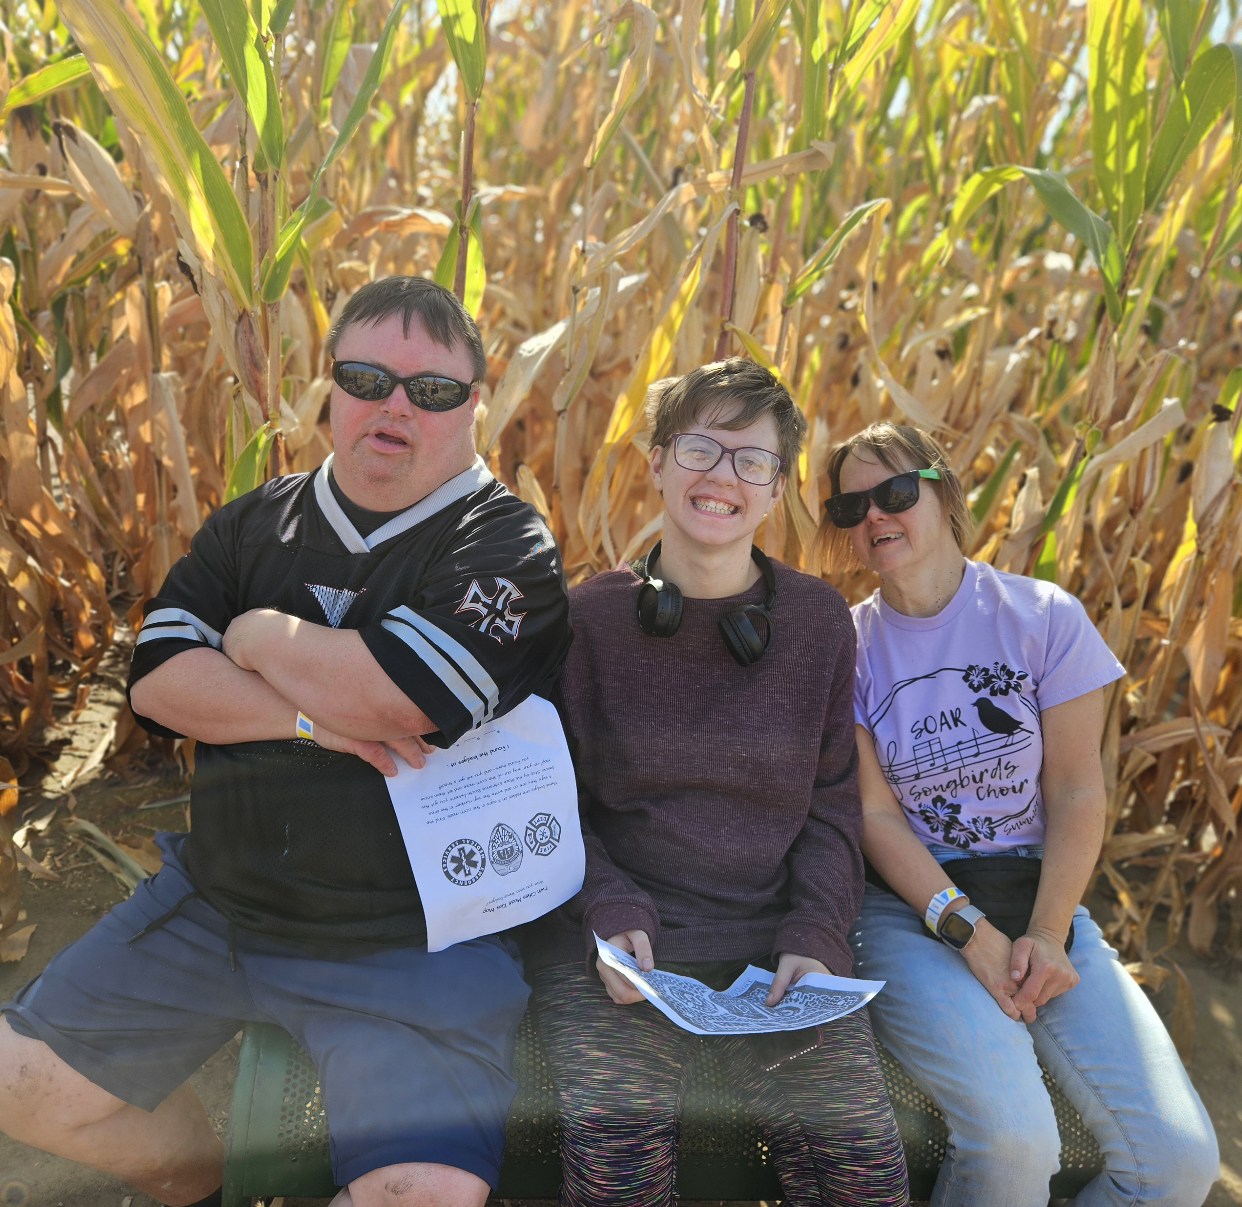
Person Centered Service Planning Continued…
7. Providing the most integrated setting and inclusive service delivery that supports, promotes, and allows:
inclusion and participation in the person's community as desired by the person in a manner that enables the person to interact with nondisabled persons to the fullest extent possible and supports the person in developing and maintaining a role as a valued community member;
opportunities for self-sufficiency as well as developing and maintaining social relationships and natural supports; and
a balance between risk and opportunity, meaning the least restrictive supports or interventions necessary are provided in the most integrated settings in the most inclusive manner possible to support the person to engage in activities of the person's own choosing that may otherwise present a risk to the person's health, safety, or rights

